Slide 1
Lecture 10
Yacc - Yet Another Compiler-Compiler
Course Leader:
Hari Krishna S M
harikrishna.cs.et@msruas.ac.in

Slide 2
Objectives
At the end of this lecture, students will be able to answer,
Introduction to Yacc
Working of Yacc
Difference between Lex and Yacc and how exactly both can be combined to work with
The communication between LEX and YACC
Parser, Scanner, Yacc Command, Precedence / Association, Shift / Reduce Conflicts

Slide 3
Introduction
What is YACC ?
  Tool which will produce a parser for a given grammar
  YACC (Yet Another Compiler Compiler) is a program designed to compile a LALR(1) grammar and to produce the source code of the syntactic analyzer of the language produced by this grammar

Slide 4
How YACC Works
gram.y
yacc
yacc program
y.tab.c
C source program created by yacc
cc
or gcc
C compiler
a.out
Executable program that will parse
grammar given in gram.y

Slide 5
How YACC Works
y.tab.h
yacc
YACC source (*.y)
y.tab.c
y.output
(1) Parser generation time
C compiler/linker
y.tab.c
a.out
(2) Compile time
Abstract
Syntax
Tree
a.out
Token stream
(3) Run time

Slide 6
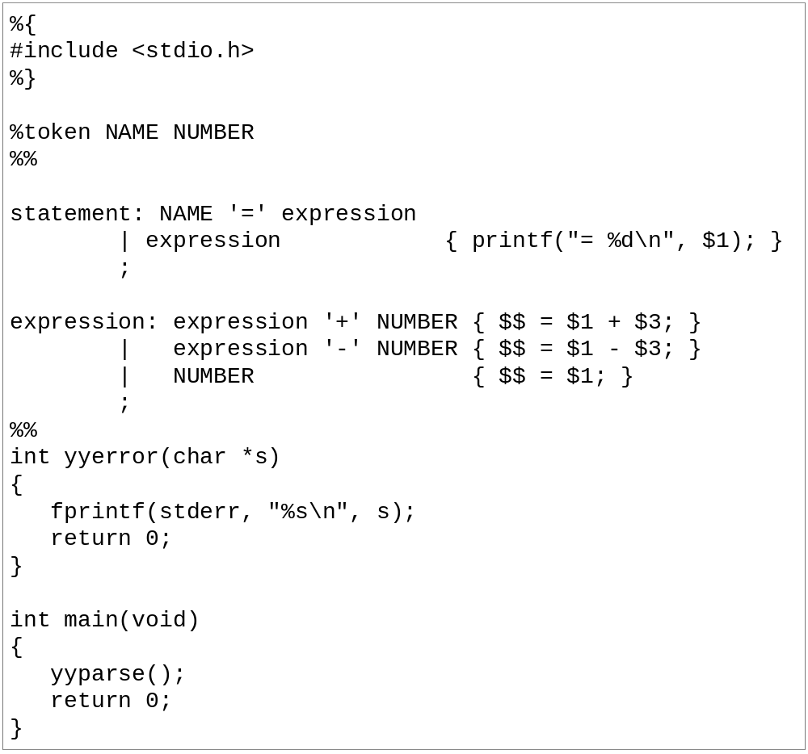
An YACC File Example

Slide 7
Lex v/s Yacc
Lex
  Lex generates C code for a lexical analyzer, or scanner
  Lex uses patterns that match strings in the input and converts the strings to tokens
Yacc
  Yacc generates C code for syntax analyzer, or parser.
  Yacc uses grammar rules that allow it to analyze tokens from Lex and create a syntax tree.

Slide 8
Lex with Yacc
Lex source
(Lexical Rules)
Yacc source
(Grammar Rules)
Lex
Yacc
lex.yy.c
y.tab.c
call
yylex()
yyparse()
Parsed
Input
Input
return token

Slide 9
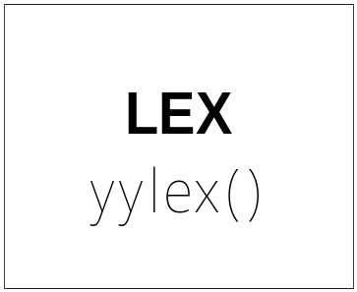
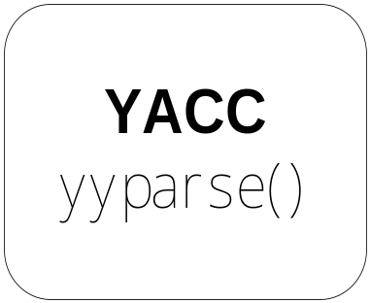
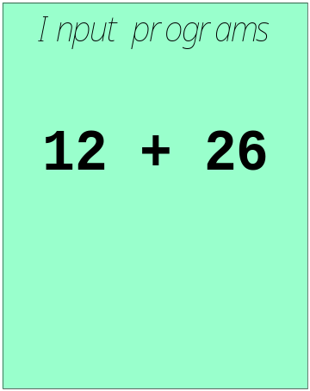
Works with Lex
How to work ?

Slide 10
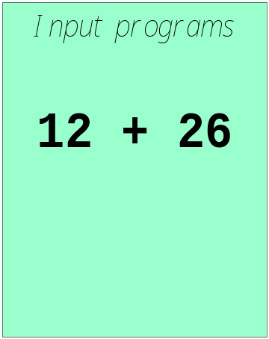
Works with Lex
[0-9]+
call yylex()
next token is NUM
NUM ‘+’ NUM

Slide 11
YACC File Format
%{
  C declarations
  %}
  yacc declarations
  %%
  Grammar rules
  %%
  Additional C code
  Comments enclosed in /* ... */ may appear in any of the sections.

Slide 12
Definitions Section
%{
#include <stdio.h>
#include <stdlib.h>
%}
%token ID NUM
%start expr
It is a terminal
Expr parse

Slide 13
Start Symbol
The first non-terminal specified in the grammar specification section
To overwrite it with %start declaration
%start non-terminal

Slide 14
Rules Section
This section defines grammar
Example
expr : expr '+' term | term;
term : term '*' factor | factor;
factor : '(' expr ')' | ID | NUM;

Slide 15
Rules Section
Normally written like this
Example:
expr : expr '+' term
| term
;
term : term '*' factor
| factor
;
factor : '(' expr ')'
| ID
| NUM
;

Slide 16
The Position of Rules
expr : expr '+' term { $$ = $1 + $3; }
| term { $$ = $1; }
;
term : term '*' factor { $$ = $1 * $3; }
| factor { $$ = $1; }
;
factor : '(' expr ')' { $$ = $2; }
| ID
| NUM
;

Slide 17
The Position of Rules
$1
expr : expr '+' term { $$ = $1 + $3; }
| term { $$ = $1; }
;
term : term '*' factor { $$ = $1 * $3; }
| factor { $$ = $1; }
;
factor : '(' expr ')' { $$ = $2; }
| ID
| NUM
;

Slide 18
The Position of Rules
expr : expr '+' term { $$ = $1 + $3; }
| term { $$ = $1; }
;
term : term '*' factor { $$ = $1 * $3; }
| factor { $$ = $1; }
;
factor : '(' expr ')' { $$ = $2; }
| ID
| NUM
;
$2

Slide 19
The Position of Rules
expr : expr '+' term { $$ = $1 + $3; }
| term { $$ = $1; }
;
term : term '*' factor { $$ = $1 * $3; }
| factor { $$ = $1; }
;
factor : '(' expr ')' { $$ = $2; }
| ID
| NUM
;
$3
Default: $$ = $1;

Slide 20
Communication between LEX and YACC
[0-9]+
call yylex()
next token is NUM
NUM ‘+’ NUM
LEX and YACC token

Slide 21
Communication between LEX and YACC
Use enumeration () / define
include
  YACC y.tab.h
  LEX include y.tab.h
yacc -d gram.y
Will produce:
y.tab.h

Slide 22
Communication between LEX and YACC
yacc -d xxx.y
Produced
y.tab.h:
# define CHAR 258
# define FLOAT 259
# define ID 260
# define INT 261
%{
#include <stdio.h>
#include "y.tab.h"
%}
id [_a-zA-Z][_a-zA-Z0-9]*
%%
int { return INT; }
char { return CHAR; }
float { return FLOAT; }
{id} { return ID;}
scanner.l
%{
#include <stdio.h>
#include <stdlib.h>
%}
%token CHAR, FLOAT, ID, INT
%%
parser.y

Slide 23
YACC
Rules may be recursive
Rules may be ambiguous*
Uses bottom up Shift/Reduce parsing
  Get a token
  Push onto stack
  Can it reduced (How do we know?)
    If yes: Reduce using a rule
    If no: Get another token
Yacc cannot look ahead more than one token
Phrase -> cart_animal AND CART
| work_animal AND PLOW
…

Slide 24
Yacc Example
Taken from Lex & Yacc
Simple calculator
  a = 4 + 6
  a
  a=10
  b = 7
  c = a + b
  c
  c = 17
  $

Slide 25
Grammar
expression ::= expression '+' term |
expression '-' term |
term
term ::= term '*' factor |
term '/' factor |
factor
factor ::= '(' expression ')' |
'-' factor |
NUMBER |
NAME

Slide 26
Parser (cont’d)
statement_list: statement '\n'
| statement_list statement '\n'
;
statement: NAME '=' expression { $1->value = $3; }
| expression { printf("= %g\n", $1); }
;
expression: expression '+' term { $$ = $1 + $3; }
| expression '-' term { $$ = $1 - $3; }
| term
;

Slide 27
Parser (cont’d)
term: term '*' factor { $$ = $1 * $3; }
| term '/' factor { if ($3 == 0.0)
yyerror("divide by zero");
else
$$ = $1 / $3;
}
| factor
;

Slide 28
Parser (cont’d)
factor: '(' expression ')' { $$ = $2; }
| '-' factor { $$ = -$2; }
| NUMBER { $$ = $1; }
| NAME { $$ = $1->value; }
;
%%

Slide 29
Scanner
%{
#include "y.tab.h"
#include "parser.h"
#include <math.h>
%}
%%
([0-9]+|([0-9]*\.[0-9]+)([eE][-+]?[0-9]+)?) {
yylval.dval = atof(yytext);
return NUMBER;
}
[ \t] ; /* ignore white space */

Slide 30
Scanner (cont’d)
[A-Za-z][A-Za-z0-9]* { /* return symbol pointer */
yylval.symp = symlook(yytext);
return NAME;
}
"$" { return 0; /* end of input */ }
\n |”=“|”+”|”-”|”*”|”/” return yytext[0];
%%

Slide 31
YACC Command
Yacc (AT&T)
  yacc –d xxx.y
Bison (GNU)
  bison –d –y xxx.y
產生y.tab.c, 與yacc相同
不然會產生xxx.tab.c

Slide 32
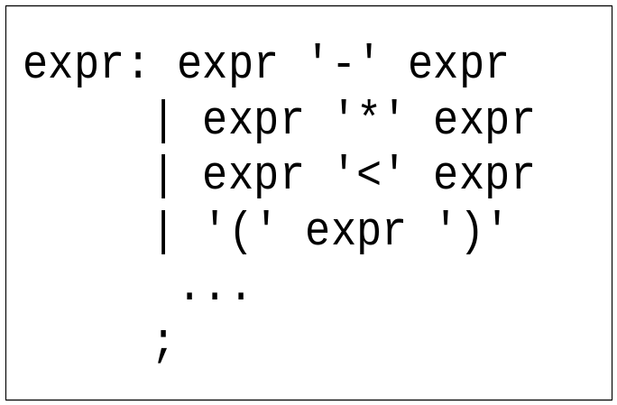
Precedence / Association
(1) 1 – 2 - 3
(2) 1 – 2 * 3
1-2-3 = (1-2)-3? or 1-(2-3)?
Define ‘-’ operator is left-association.
1-2*3 = 1-(2*3)
Define “*” operator is precedent to “-” operator

Slide 33
Precedence / Association
%right ‘=‘
%left '<' '>' NE LE GE
%left '+' '-‘
%left '*' '/'
highest precedence

Slide 34
Precedence / Association
%left '+' '-'
%left '*' '/'
%noassoc UMINUS
expr : expr ‘+’ expr { $$ = $1 + $3; }
| expr ‘-’ expr { $$ = $1 - $3; }
| expr ‘*’ expr { $$ = $1 * $3; }
| expr ‘/’ expr
{
if($3==0)
yyerror(“divide 0”);
else
$$ = $1 / $3;
}
| ‘-’ expr %prec UMINUS {$$ = -$2; }

Slide 35
Shift/Reduce Conflicts
shift/reduce conflict
  occurs when a grammar is written in such a way that a decision between shifting and reducing can not be made
  ex: IF-ELSE ambiguous
To resolve this conflict, yacc will choose to shift

Slide 36
Summary
`%start'
Specify the grammar's start symbol
`%union'
Declare the collection of data types that semantic values may have
`%token'
Declare a terminal symbol (token type name) with no precedence or
associativity specified
`%type'
Declare the type of semantic values for a nonterminal symbol

Slide 37
Summary
`%right'
Declare a terminal symbol (token type name) that is
right-associative
`%left'
Declare a terminal symbol (token type name) that is left-associative
`%nonassoc'
Declare a terminal symbol (token type name) that is nonassociative
(using it in a way that would be associative is a syntax error,
ex: x op. y op. z is syntax error)

